Slide 1
Using and Maintaining GIT
AM DevOPS Internship, MARCH 2017

Slide 2




agenda
Intro in VCS
Git – starter-pack
Making Commit
Understanding Branches
Fixing your commits
resolving Conflicts
MAKE your git better
Git servers

Slide 3
Intro in vcs
What is VCS ?
VCS = Version Control System
Why must we use them?
Backtrack. Reverse a change. Save all copies in 1. Easy share. Centralized project storing.

Slide 4
GIT – starter-pack
BEFORE YOU START – CONFIGURE gIT
git config -l - show your current config git config [--global] user.name “John Doe” - set up the user name
git config [--global] user.email john.doe@example.com - set up user email
use --global parameter if you want to configure all repos on your local
Repository creating
git init – initialize a local git repo in current directory git clone <remote repo link> – clone the repository from the remote
git status – show status of current HEAD

Slide 5
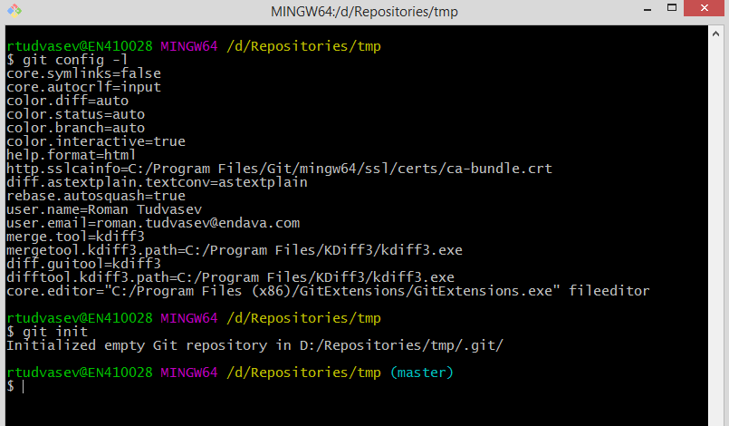
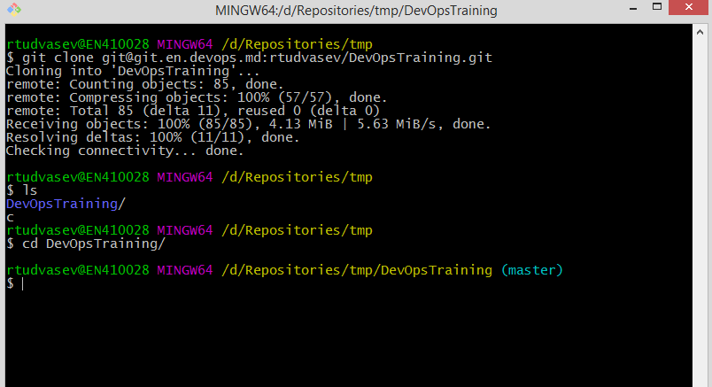
GiT – starter-pack

Slide 6
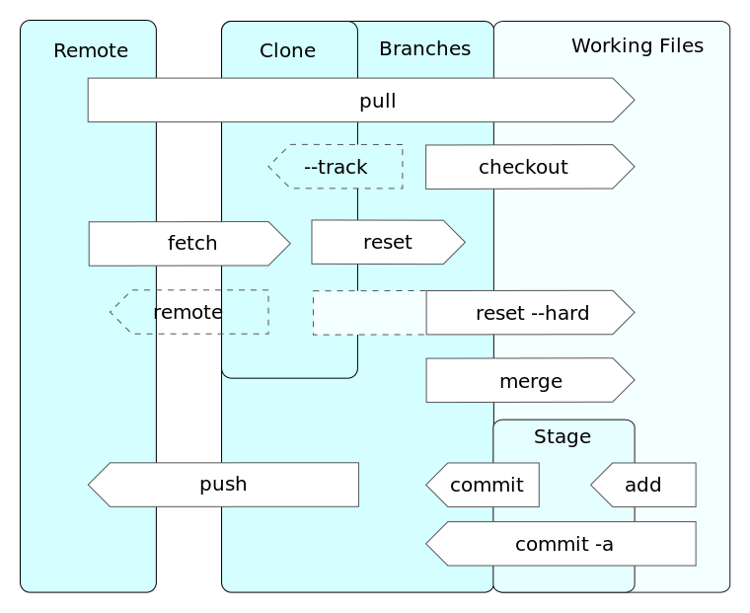
Making commit
Understanding git flow
The standard git flow is very simple :
Checking remote for new commits
git pull <remote> <branch>
git fetch
Making changes
Add changed files into stage
git add <files>
Performing commit on local
git commit
git commit –m “<commit message>”
Pushing your commit to server
git push <remote> <branch>

Slide 7
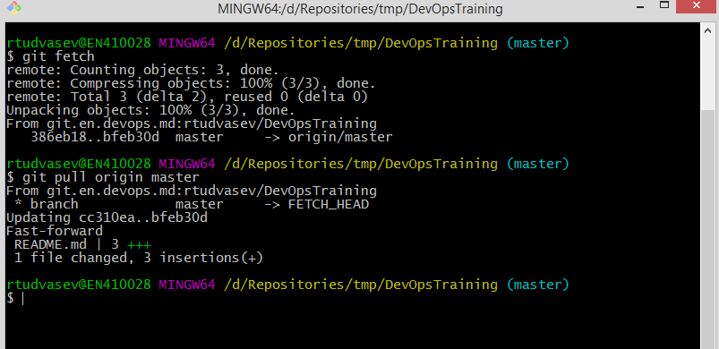
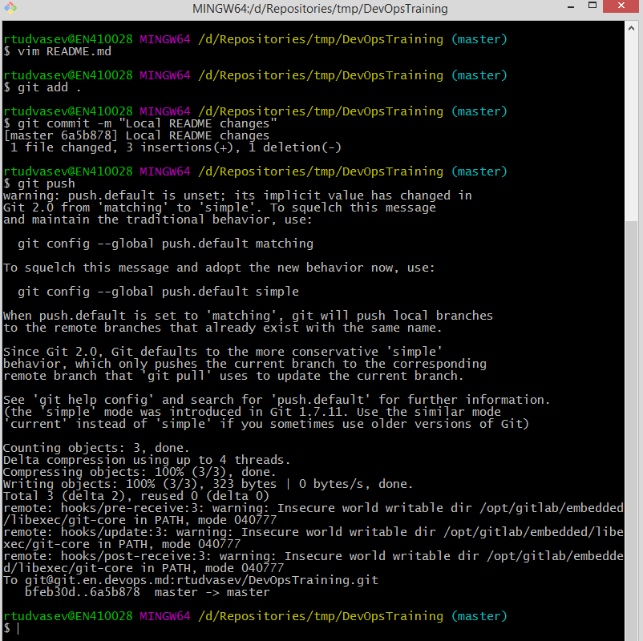
Making commit

Slide 8
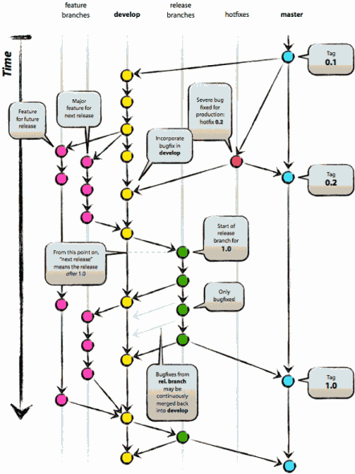
Understanding branches
What is branch ?
Working with branch
git branch <name>
git checkout <name>
Updating tree
git rebase <src> <dest>
git merge [-s <strategy>] [<src>] <dest>
git cherry-pick <commit>
git tag [<commit>] <name>

Slide 9
Fixing your commits
Finding your bad
git log – displays the history of the repo. There are a lot of options that allows you to specify search criteria.
Reset vs revert
git reset [--soft | --hard] <commit> [<filename>] – resetting repo without creating new commit
git revert <commit> - resetting repo with new commit
checkout
git checkout <commit> [<filename>] – changes HEAD of repo to certain commit
Stashing your changes
git stash – stashes all of the changes you haven`t committed yet
git stash pop – apply the last stash on top of current branch

Slide 10
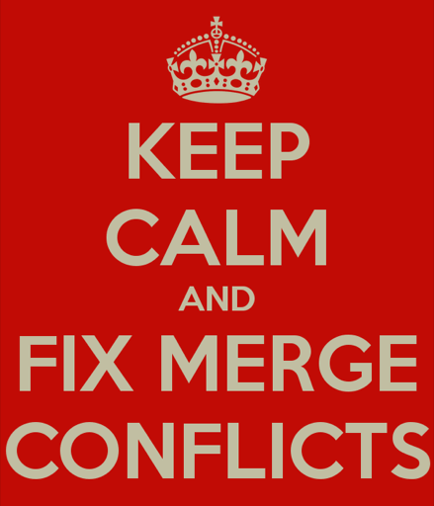
resolving Conflicts
What is Conflict in GIT?
What does cause the conflicts ?
- Edit collision
- Remove file collision
=> MERGE
How to solve the conflicts ?
1) Identify the problem
2) Solve it by choosing the correct path. A) Choose the correct piece of code to save
B) Remove the file
3) Commit changes
DON`T FORGET ABOUT MERGE TOOLS!

Slide 11
Make your git better
Git gui clients
Additional git utils
GIT Best practices
Git Extensions
Source Tree
Smart Git
Tower
Kdiff 3
p4merge
Svn2git
git-svn
git-hg
git-tfs
git LFS
Commit often
Do think what you commit
Do make useful commit messages
Do keep up to date
Do use branches
Do think on workflow and branching strategy
Do read about Git
DO NOT PANIC

Slide 12
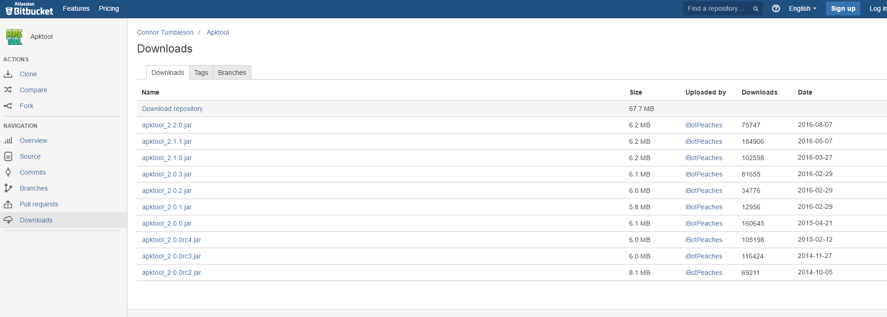
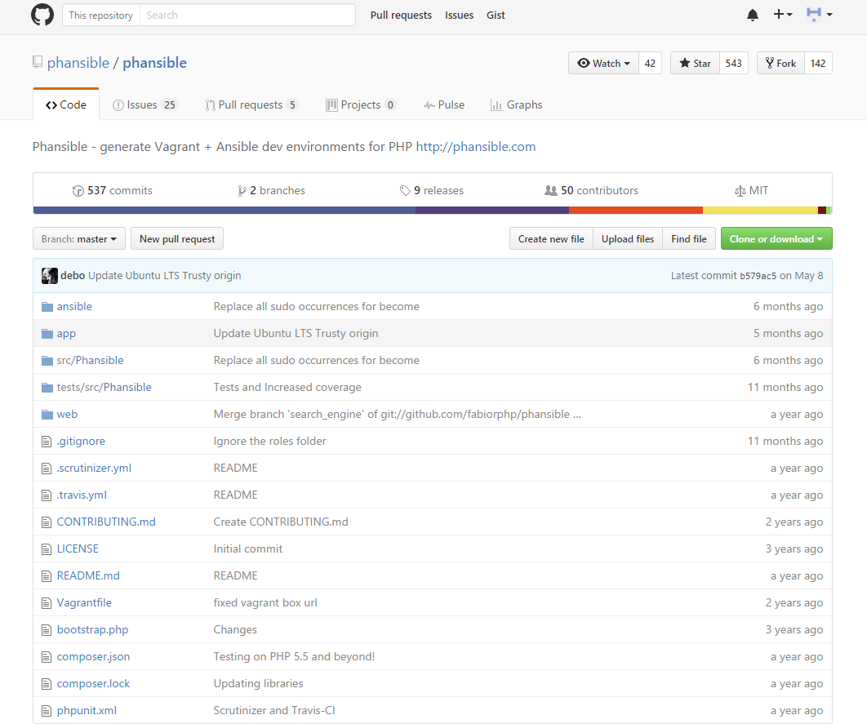
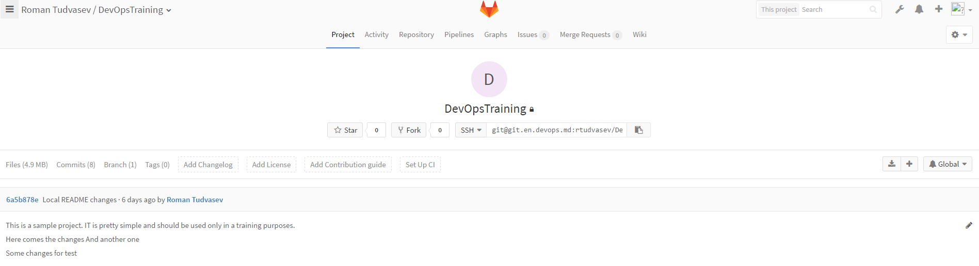
Git servers
GitHub vs gitlab vs bitbucket

Slide 13
Useful Links
https://git-scm.com/
https://about.gitlab.com/
https://www.atlassian.com/git/tutorials/learn-git-with-bitbucket-cloud
https://try.github.io/levels/1/challenges/1
https://githowto.com/
http://www.tutorialspoint.com/git/
https://git-scm.com/book/en/v2
https://biz30.timedoctor.com/git-mecurial-and-cvs-comparison-of-svn-software/
http://zeroturnaround.com/wp-content/uploads/2016/02/Git-Cheat-Sheet.png
http://zeroturnaround.com/rebellabs/git-commands-and-best-practices-cheat-sheet/
https://sourceforge.net/projects/gitextensions/
https://sourceforge.net/projects/kdiff3/
https://habrahabr.ru/company/mailru/blog/318508/
https://www.youtube.com/playlist?list=PLDshL1Z581YYxLsjYwM25HkIYrymXb7H_

Slide 14
Roman Tudvasev
AM Engeneer
Roman.Tudvasev@endava.com

